Slide 1
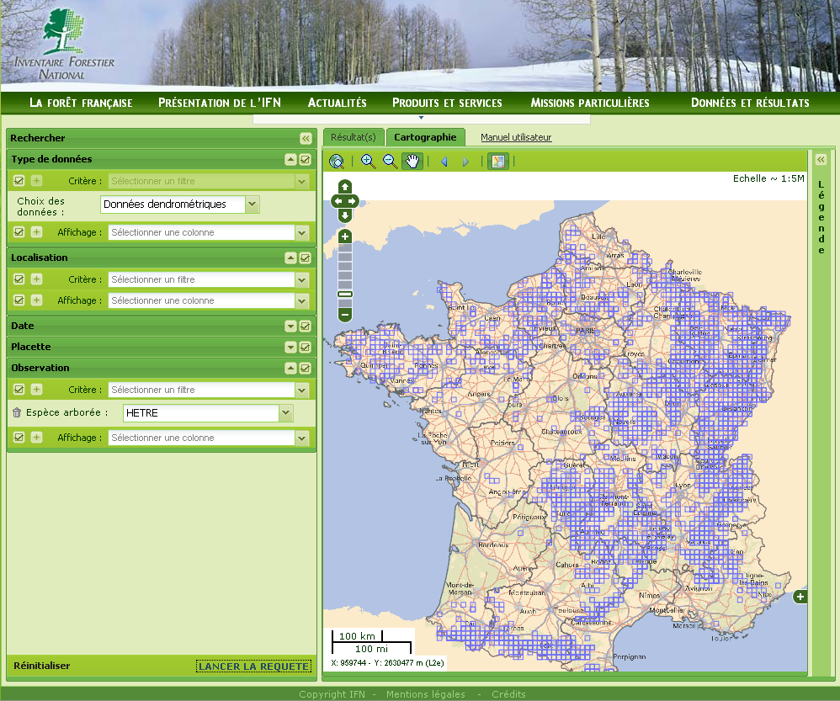
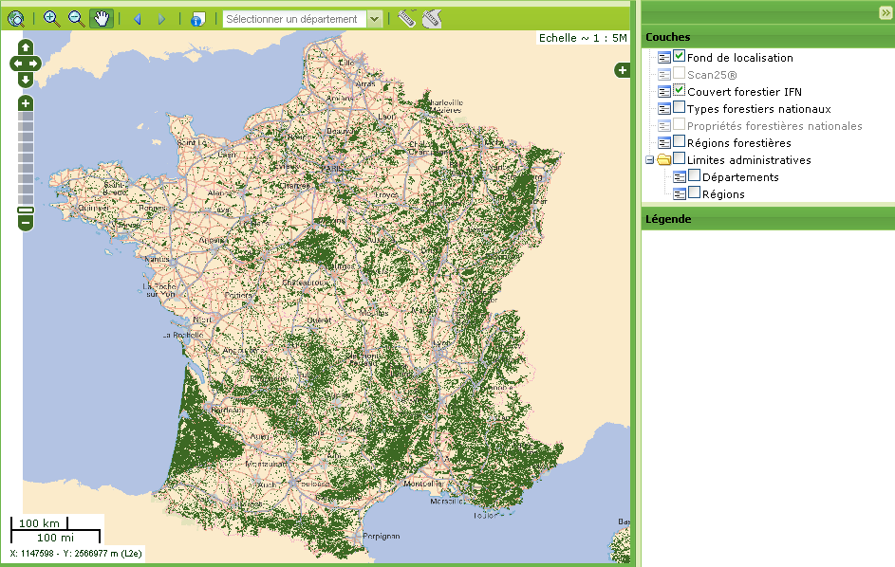
Interactive Tool
Map Viewer
Spatial
representation
aggregated database
Spatial representation
Grid aggregation
Metadata database
Raw database
Data query builder
Data gathering
Authentication
Internet

